Slide 1
Advertizing and Media Persuasive Techniques
Eng 12/Bailey

Slide 2
Propaganda
a form of communication that is aimed at influencing the attitude of a community toward some cause or position by presenting only one side

Slide 3
Assertion
An assertion is an enthusiastic or energetic statement presented as a fact, although it is not necessarily true.

Slide 4
Bandwagon
Bandwagon is an appeal to the subject to follow the crowd, to join in because others are doing so as well.

Slide 5
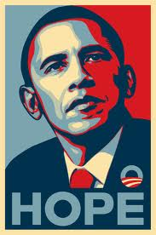
Glittering Generalities
When these words are used, they demand approval without thinking, simply because such an important concept is involved.

Slide 6
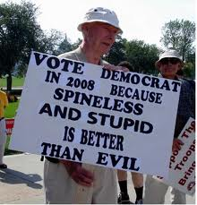
Lesser of Two Evils
The "lesser of two evils" technique tries to convince us of an idea or proposal by presenting it as the least offensive option.

Slide 7
Name Calling
the use of derogatory language or words that carry a negative connotation when describing an enemy.

Slide 8
Pinpointing the Enemy
This is an attempt to simplify a complex situation by presenting one specific group or person as the enemy.

Slide 9
Plain Folks
The plain folks device is an attempt by the propagandist to convince the public that his views reflect those of the common person and that they are also working for the benefit of the common person.

Slide 10
Testimonials
Testimonials are quotations or endorsements, in or out of context, which attempt to connect a famous or respectable person with a product or item.

Slide 11
Transfer
an attempt to make the subject view a certain item in the same way as they view another item, to link the two in the subjects mind.

Slide 12
Repetition
It is generally believed that people must see an ad 9 times before they acquire enough interest to consider buying it

Slide 13
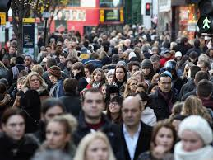
Collective Memory
Draws on shared knowledge or experiences

Slide 14
Humanizing Technology
Reduces the amount of mystery about how technology works and makes people feel safe in their changing environment

Slide 15
Strong Women
Inspire and empower women, the majority of buyers

